Slide 1
Identifying the best places to open a French restaurant in Nagoya
Jonhathan Pinon

Slide 2
Business Approach
Japan : French restaurants are popular
Nagoya : one of the largest cities in Japan
Nagoya = attractive place to open new French restaurant
Where?
Popularity = Income = Interest

Slide 3
Data Description Data Source
Data source = Foursquare API
All venues in Nagoya with positions (including French restaurants)
Problem : No data about venue popularity
Data : Inside python pandas dataframes

Slide 4
Data Description Data
Data collected:
French restaurants
Food-related restaurants
Transport-related venues
Long stay venues (Residence, Work, Education related venue)
Short stay venues (Shops, Art, Nightlife, Recreation related venues)
Data cleaning
Remove duplicates

Slide 5
Methodology
Fundamental Hypothesis :
Past shop owners chose the best places to open French restaurants
French restaurants are situated in areas suited for them
Finding areas like areas with French restaurants = finding good places to open new French restaurants

Slide 6
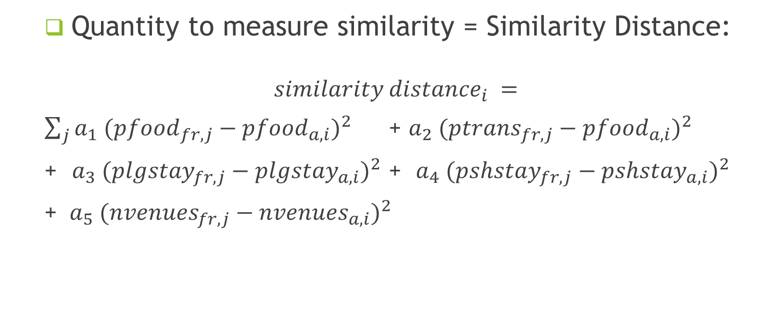
Model
Quantity to measure similarity = Similarity Distance:
$${similarity distance}_{i} =$$
$\sum_{j}{a_{1} {({pfood}_{fr,j}−{pfood}_{a,i})}^{2}}$ + $a_{2} {({ptrans}_{fr,j}−{pfood}_{a,i})}^{2}$
+ $a_{3} {({plgstay}_{fr,j}−{plgstay}_{a,i})}^{2}$ + $a_{4} {({pshstay}_{fr,j}−{pshstay}_{a,i})}^{2}$
+ ${ a}_{5} {({nvenues}_{fr,j}−{nvenues}_{a,i})}^{2}$

Slide 7
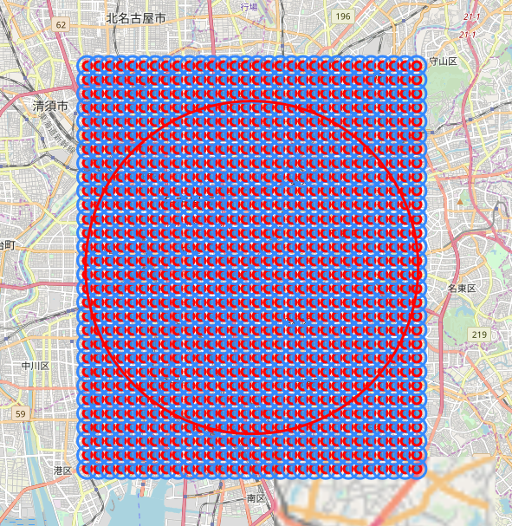
Grid of Nagoya
30 * 30 grid
One small circle ~ 330 meters
Big red circle = encompasses all French restaurants (6 kilometers)

Slide 8
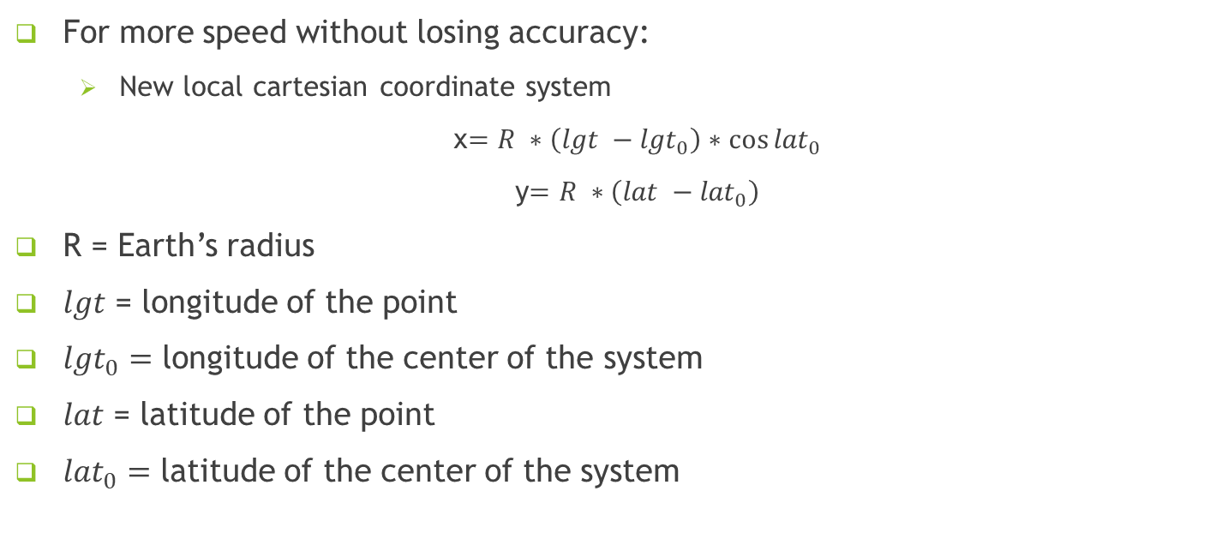
Coordinate System
For more speed without losing accuracy:
New local cartesian coordinate system
x$=R ∗\left(lgt −{lgt}_{0}\right)∗\cos{{lat}_{0}}$
y$=R ∗\left(lat −{lat}_{0}\right)$
R = Earth’s radius
$lgt$ = longitude of the point
${lgt}_{0}=$ longitude of the center of the system
$lat$ = latitude of the point
${lat}_{0}=$ latitude of the center of the system

Slide 9
F1 Score
For each area, calculate similarity distance
Get number of areas with at least one French restaurant = nb_areas_with_fr
Sort the areas by smallest similarity distance
The nb_areas_with_fr areas with the smallest distances are predicted to have at least one French restaurants
Compare reals and predicted French restaurants
F1 score

Slide 10
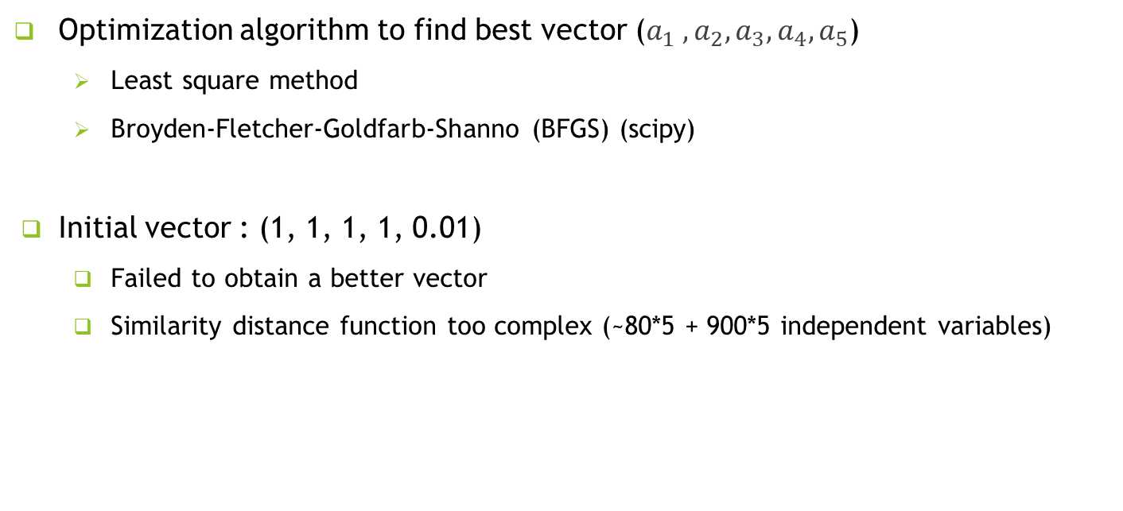
Result Vector
Optimization algorithm to find best vector ($a_{1} ,a_{2},a_{3},a_{4},a_{5}$)
Least square method
Broyden-Fletcher-Goldfarb-Shanno (BFGS) (scipy)
Initial vector : (1, 1, 1, 1, 0.01)
Failed to obtain a better vector
Similarity distance function too complex (~80*5 + 900*5 independent variables)

Slide 11
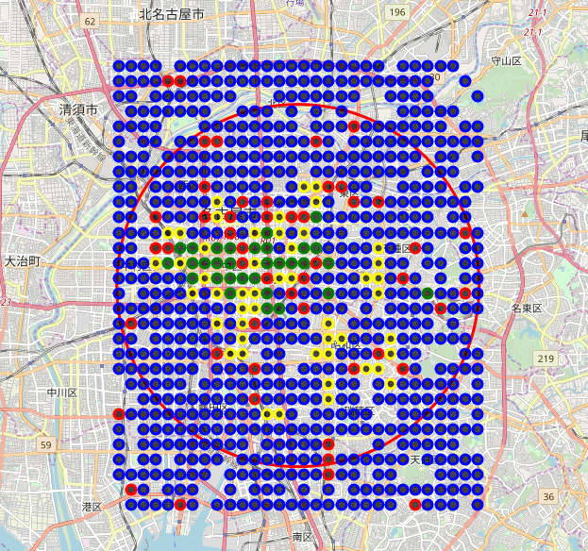
Result Complete set, zoom
Green = True Positive
Red = False Positive
Yellow = False Negative
Blue = True Negative

Slide 12
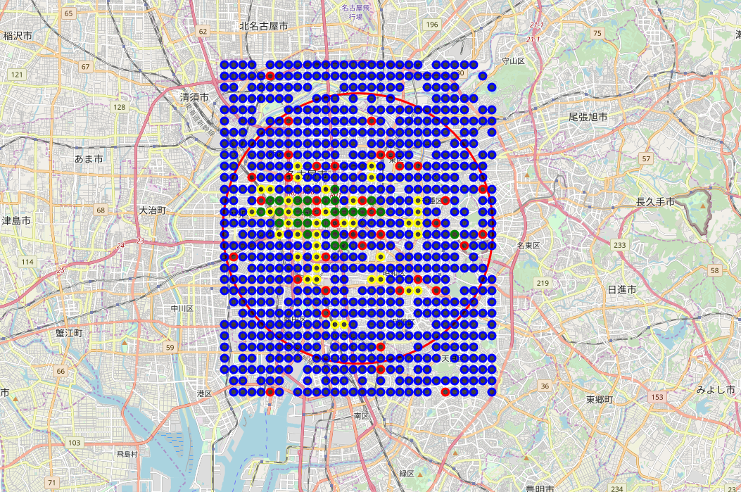
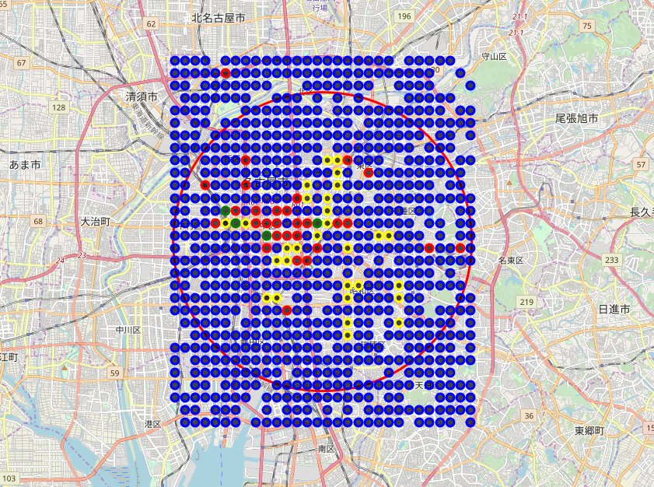
Result Maps
Training Set
F1 = 0.40625
Test Set
F1 = 0.1212
Complete Set
F1 = 0.3875

Slide 13
Discussion
true positive + false positive = real number of areas with French restaurant
true negative + false negative = real number of areas without French restaurant
F1 score ~ 0.4
Model is inaccurate
Average F1 score of random model ~ 0.1
Model still far better than random
Recommended areas to open French restaurants = areas with consecutive False Positives and without True Positives or False Negatives.

Slide 14
Conclusion
Best areas for new French restaurants
Look for areas like areas with French restaurants
Data using Foursquare and pandas (python)
French restaurant, food, transport, long stay, short stay
Similarity distance
Bad : F1 score = ~0.4
But good enough for pedagogic purposes
Improvements
Data about popularity, visits
Different radius, different initial vector, model

Slide 15
Thank you for reading this presentation

